Slide 1

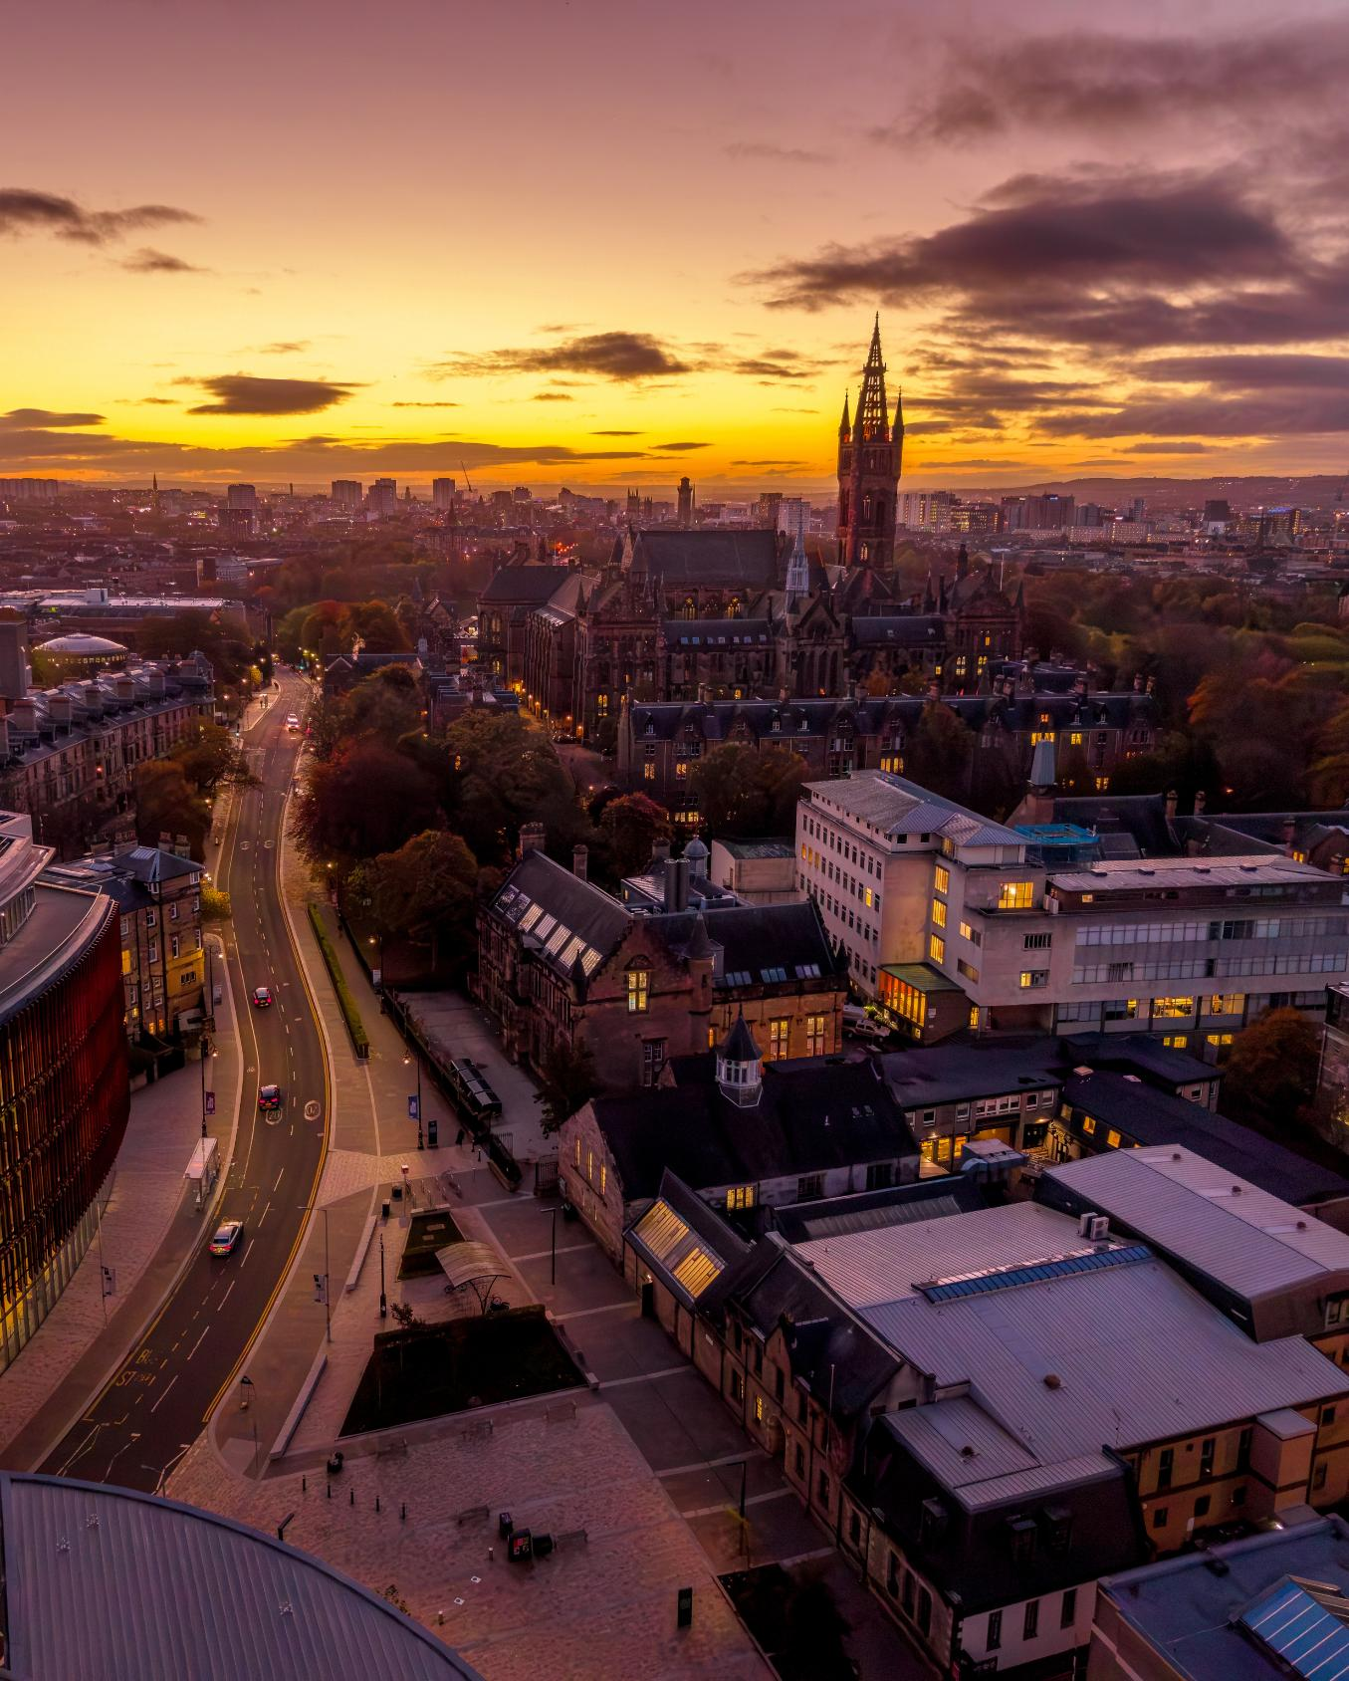
World Top 70
University
for Arts &
Humanities
(QS 2026)
Studying [PROGRAMME NAME] MSc
at Glasgow
Change the future of global culture in the UK’s top city for culture and creativity*
*European Commission, 2019

Slide 2
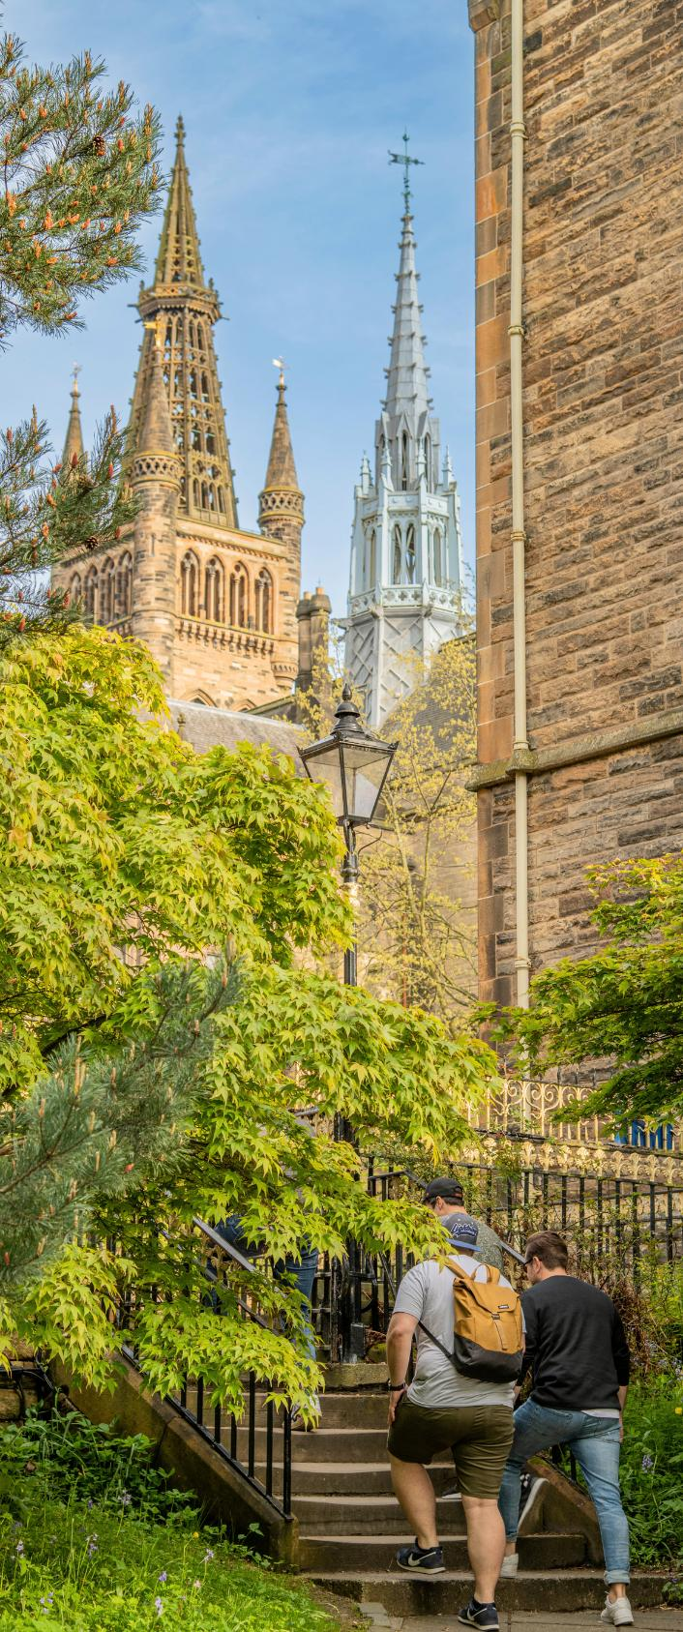
Introducing [PROGRAMME NAME] MSc at Glasgow
Headline 1: A one-year Masters programme that...
Headline 2
Headline 3

Slide 3
Meet Your Programme Convenor,
Professor/Dr...
Your role at UofG
Your research interests
Key awards and recent publications
Other relevant info

Slide 4

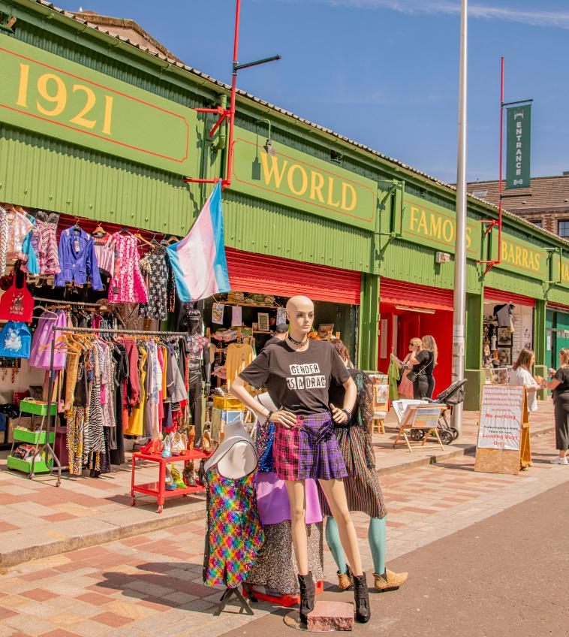
Why Study [PROGRAMME] Today?
COPY 1: What skills and knowledge will students gain?
COPY 2: What resources, equipment and/or networks will students have access to?
COPY 3: What challenges and careers will the programme prepare them for?

Slide 5
World Top 70
Why Choose Glasgow?
University
for Arts &
Humanities
(QS 2026)
We’re a World Top 70 University for Arts & Humanities (QS, 2026) in the UK's friendliest city (Condé Nast, 2025) – the UK’s first UNESCO City of Music, recognised as its top cultural and creative city (European Commission, 2019), and host of major global events including COP26 and Glasgow 2026 Commonwealth Games
Home to over 100 cultural organisations, 20+ museums and galleries, and four of Scotland's five national performing arts companies – and one of the world's top five student cities, as rated by students themselves (QS, 2025)
Glasgow is the creative hub of Scotland, home to 41% of its actors, dancers and broadcasters, 38% of its musicians, and 29% of its artists and graphic designers – an unrivalled place to study, network and begin a career in cultural enterprise
Join a Russell Group university community of 43,000 students from 140 countries, a global alumni network of over 300,000, and a city with deep local creative roots and genuine global reach

Slide 6

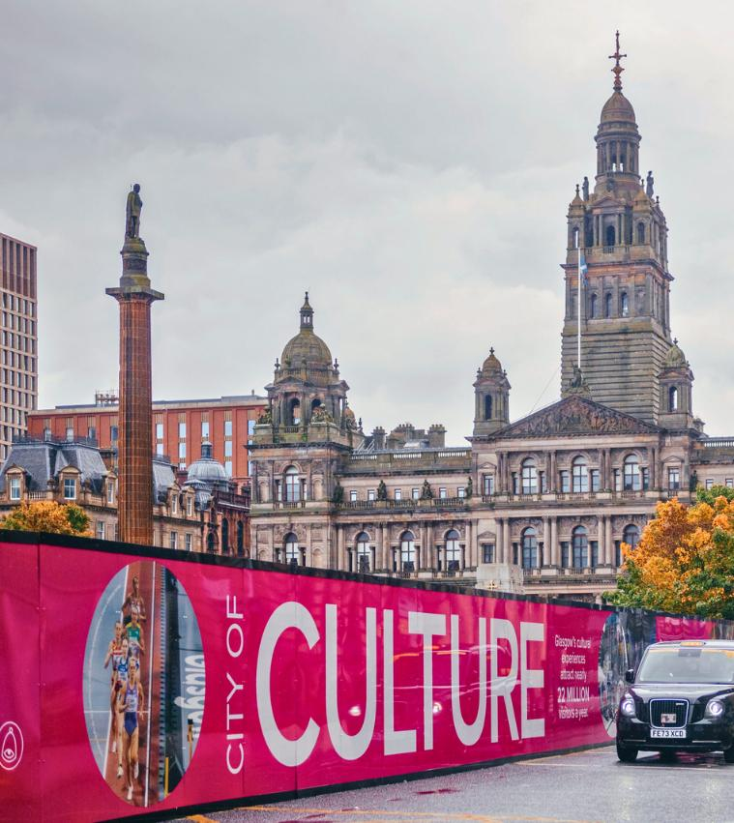
What Skills Will I Develop?
Provide details of the opportunities available to students on your programme that support skills development, employability, and engagement with industry, e.g.
Practical and technical skills development
Industry engagement activities (e.g. guest speakers, live projects, site visits, networking events)
Student placements
Internships
Work-based learning opportunities
Professional development activities and accreditation
Applied or experiential learning approaches
Employer involvement in curriculum design, delivery, assessment, or student experiences

Slide 7













Our Subject Area’s Industry Partners & Networks
Connect with our leading local and national cultural partner organisations including Creative Glasgow, SWG3, BBC, Glasgow Life, British Film Institute, BAFTA, Screen Scotland, WASPS, and the Department for Digital, Culture, Media and Sport – through guest lectures, live briefs, case studies and project pitching
Engage with major international bodies including UNESCO and the EU, gaining insight into how culture is governed, funded and developed at the highest global level
Learn directly from our international partners, including arts managers from Murara Arts and the Hong Kong Dance Company, VR/AR artists based in Singapore, and film producers working across China and the United States

Slide 8
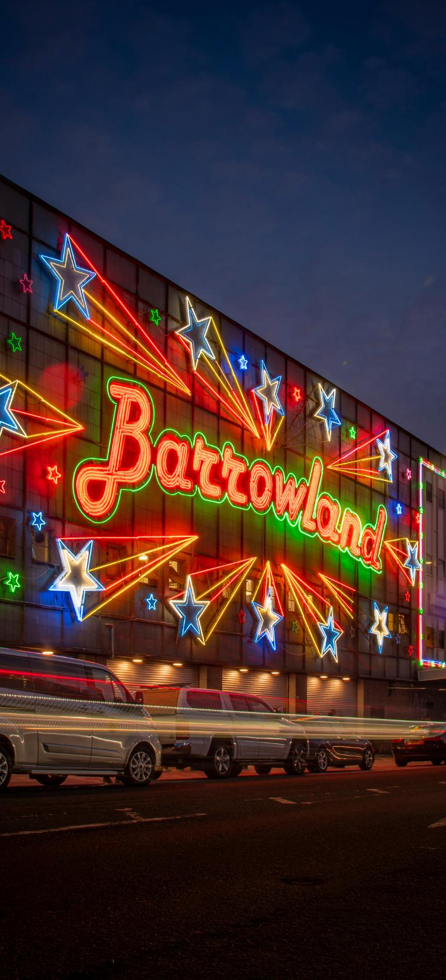
What Will I Study?
Semester 1
World Top 70
University
for Arts &
Humanities
(QS 2026)
Core Course: [COURSE TITLE] + 1 - 2 sentence summary
Choose from further optional modules across [programme catalogue], the School of Culture & Creative Arts, and the College of Arts & Humanities. Courses can include [EXAMPLE 1], [EXAMPLE 2], and [EXAMPLE 3].

Slide 9



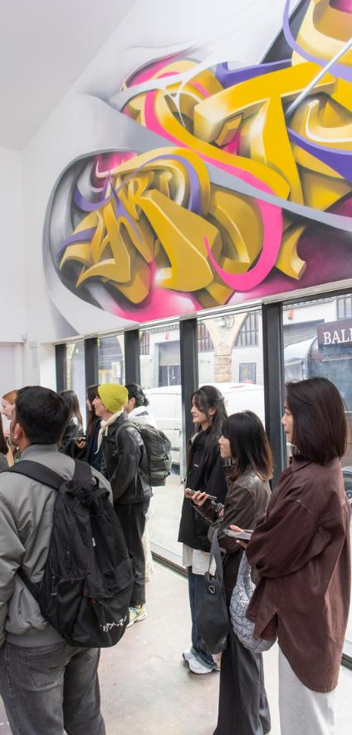
What Will I Study?
Semester 2 & Summer
Core Course: [TITLE] + 1 - 2 sentence summary.
Choose from further optional modules across , the School of Culture & Creative Arts and the College of Arts & Humanities. Courses can include [EXAMPLE 1], [EXAMPLE 2], and [EXAMPLE 3].
In the summer, you will undertake your Dissertation. You will plan and execute an original research project on a topic of your choosing, relevant to [PROGRAMME], producing a substantial piece of writing (approx. NUMBER words) This is the culmination of your studies, and an opportunity to explore a topic which matters to you and your future career.

Slide 10
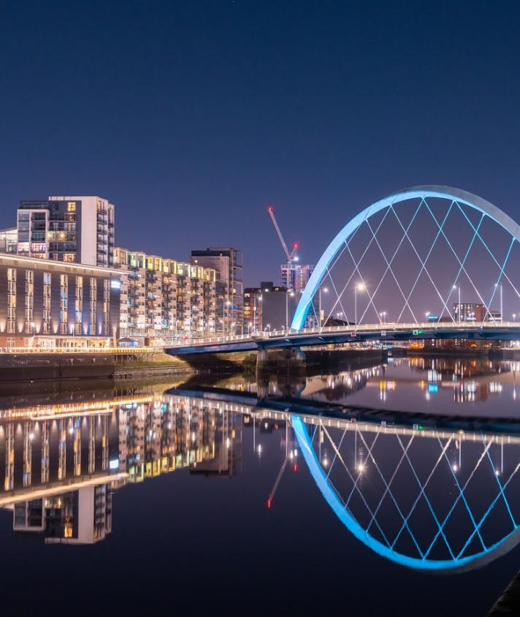
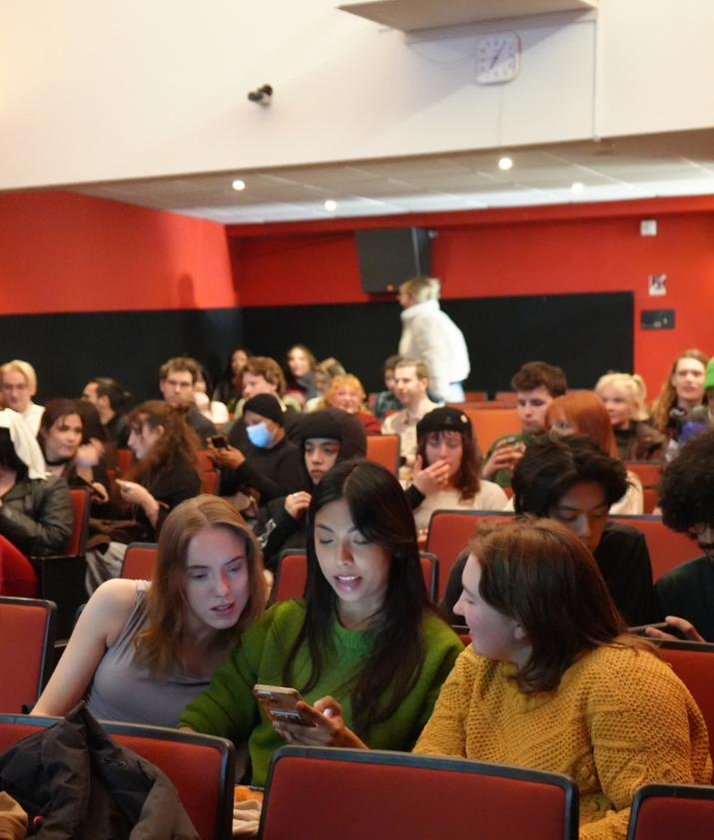
Career Prospects & Graduate Outcomes
World Top 70
University
for Arts &
Humanities
(QS 2026)
Graduates can go on to careers in...
The programme prepares you for employment in ..., and PhD study in ... research
You will be equipped to work internationally across ....

Slide 11
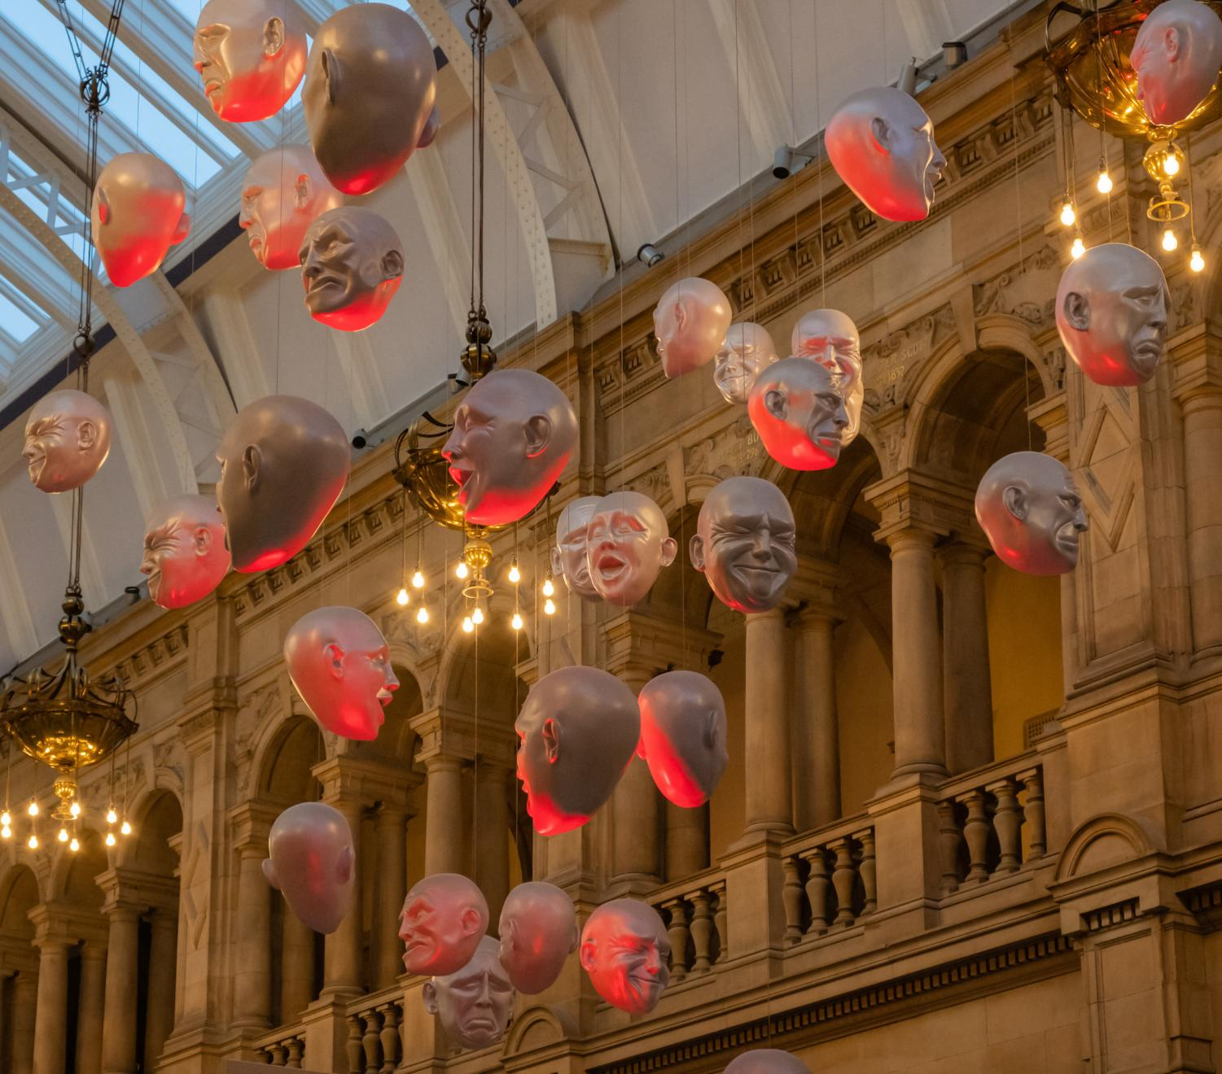
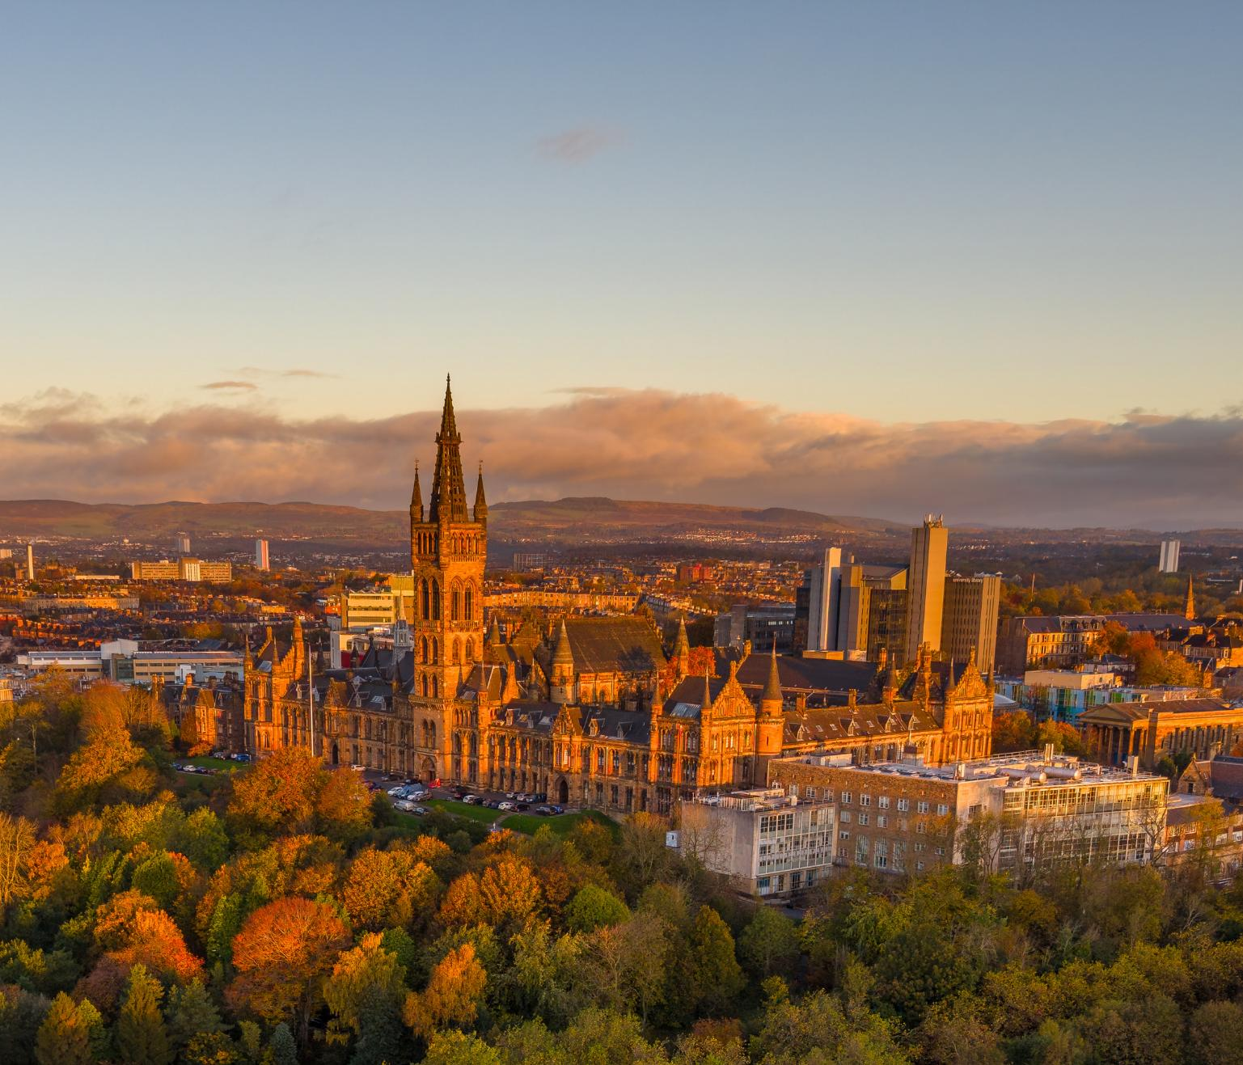
Visit our programme page to explore the full course structure, entry requirements, funding opportunities, and how to apply.
World Top 70
University
for Arts &
Humanities
(QS 2026)
Got a question?
Contact [YOUR EMAIL]@glasgow.ac.uk

